Slide 1
Practical Algorithm Analysis for Oracle Developers
281
Jon Heller
Database Administrator
Ventech Solutions
jon@jonheller.org
2019-04-10

Slide 2
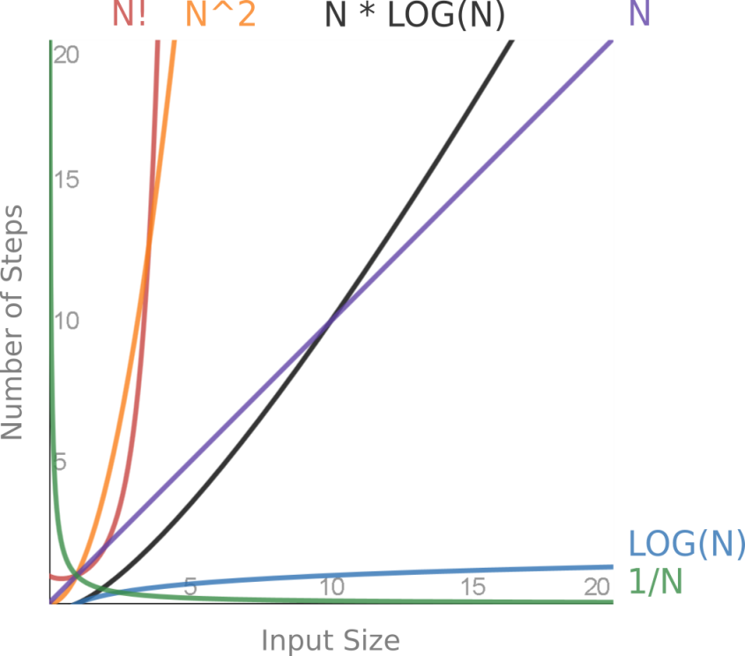
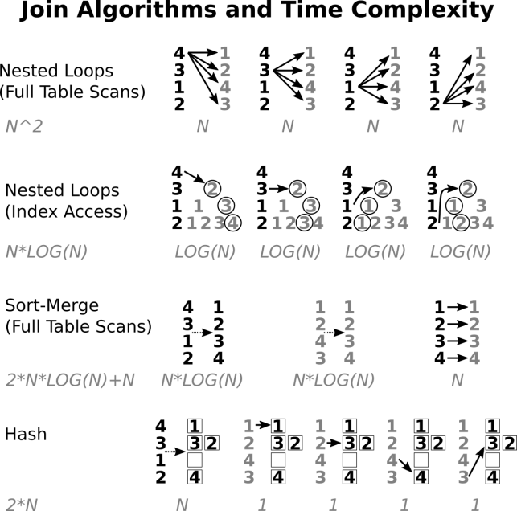
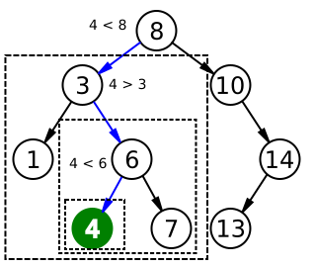
Practical Algorithm Analysis for Oracle Developers
Notes:
Binary search algorithm image created by Chris Martin and is in the public domain.

Slide 3
Disclaimers
This is not a computer science lecture
No proofs or complicated math
Imprecise terminology: computational complexity, algorithm analysis, time complexity, asymptotic complexity, run-time analysis

Slide 4
Presentation is Based on Chapter 16

Slide 5
Tuning is Hard
Most tuning is based on business logic, dev process, advanced features, and styles
Breadth-first approach needed
Many tuning styles are necessary
Algorithm analysis is foundational

Slide 6
The Stakes are High
Orders of magnitude differences in performance and skills
"a million times faster" is only the beginning

Slide 7
Run-time Analysis
Simple math
Big O notation - worst case, ignore constants
Replace "A is N times faster than B" with "A is O(N) and B is O(N^2)"
Affects a wide variety of operations
Useful for both proactive and reactive tuning
Focus on practical, not theoretical

Slide 8
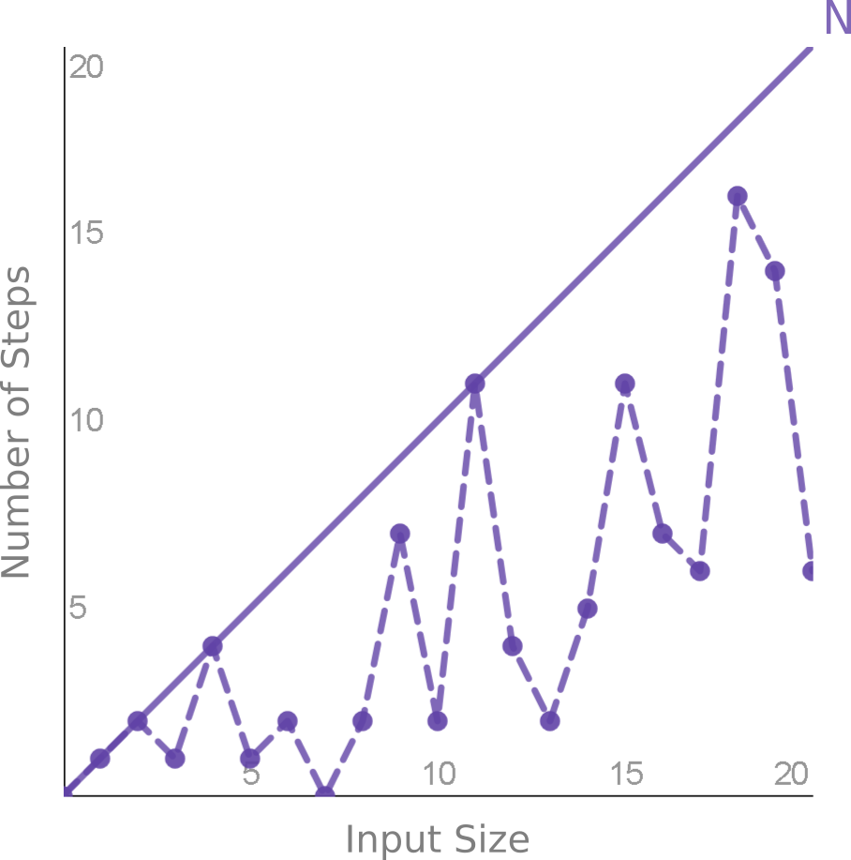
Sample Run-time Analysis
Linear search
Best case is O(1)
Average case is (N/2)*
Worst case is O(N)

Slide 9
Create a New Performance Story
Let's ignore database tuning, SQL tuning, advisors, reports, tools
Start with fastest and end with slowest
Popular functions guide us through performance categories

Slide 10
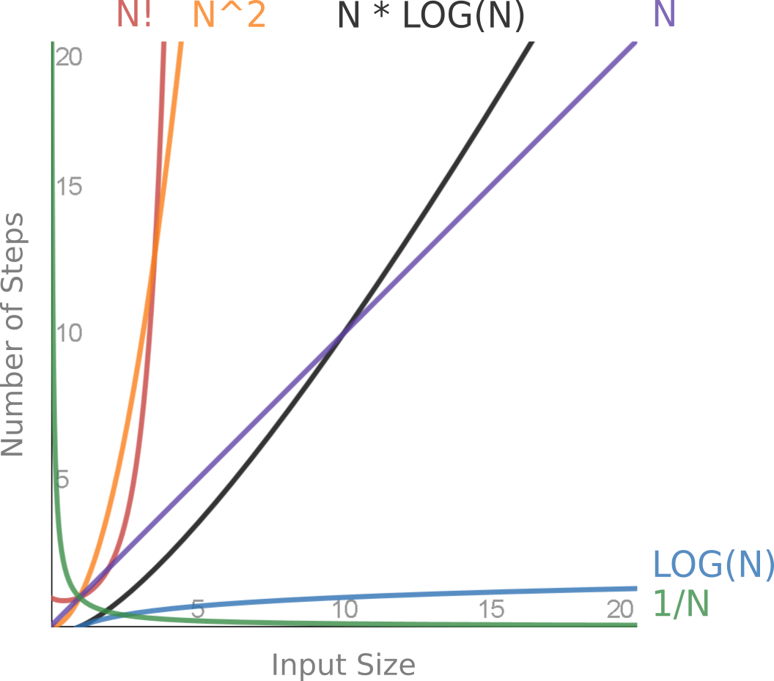
Popular Functions
Notes:
Plus O(1), O(∞), and Amdahl's Law

Slide 11
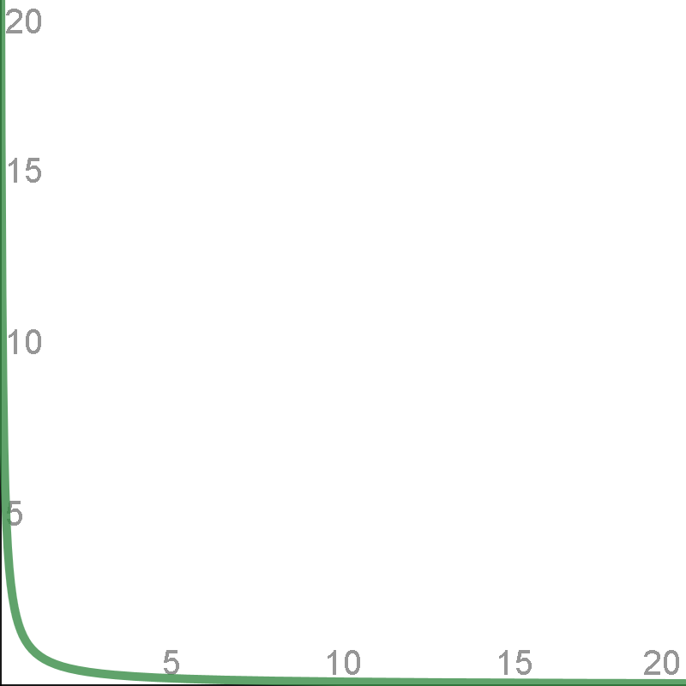
1/N

Slide 12
1/N - What and Where
Harmonic progression
Context switching for every N items
Any process with a tunable batch or cache size
Sequences, bulk collect limit, prefretch, arraysize, UNION ALL, DBMS_OUTPUT, etc.
(N * REAL_WORK) + ((N * OVERHEAD_TIME) / BATCH_SIZE)

Slide 13
1/N - Why it Matters
BATCH_SIZE 2 = 50% optimized
BATCH_SIZE 10 = 90% optimized
BATCH_SIZE 100 = 99% optimized
Why ever go over 100? Trade space for (no) time
Most tests are wrong

Slide 14
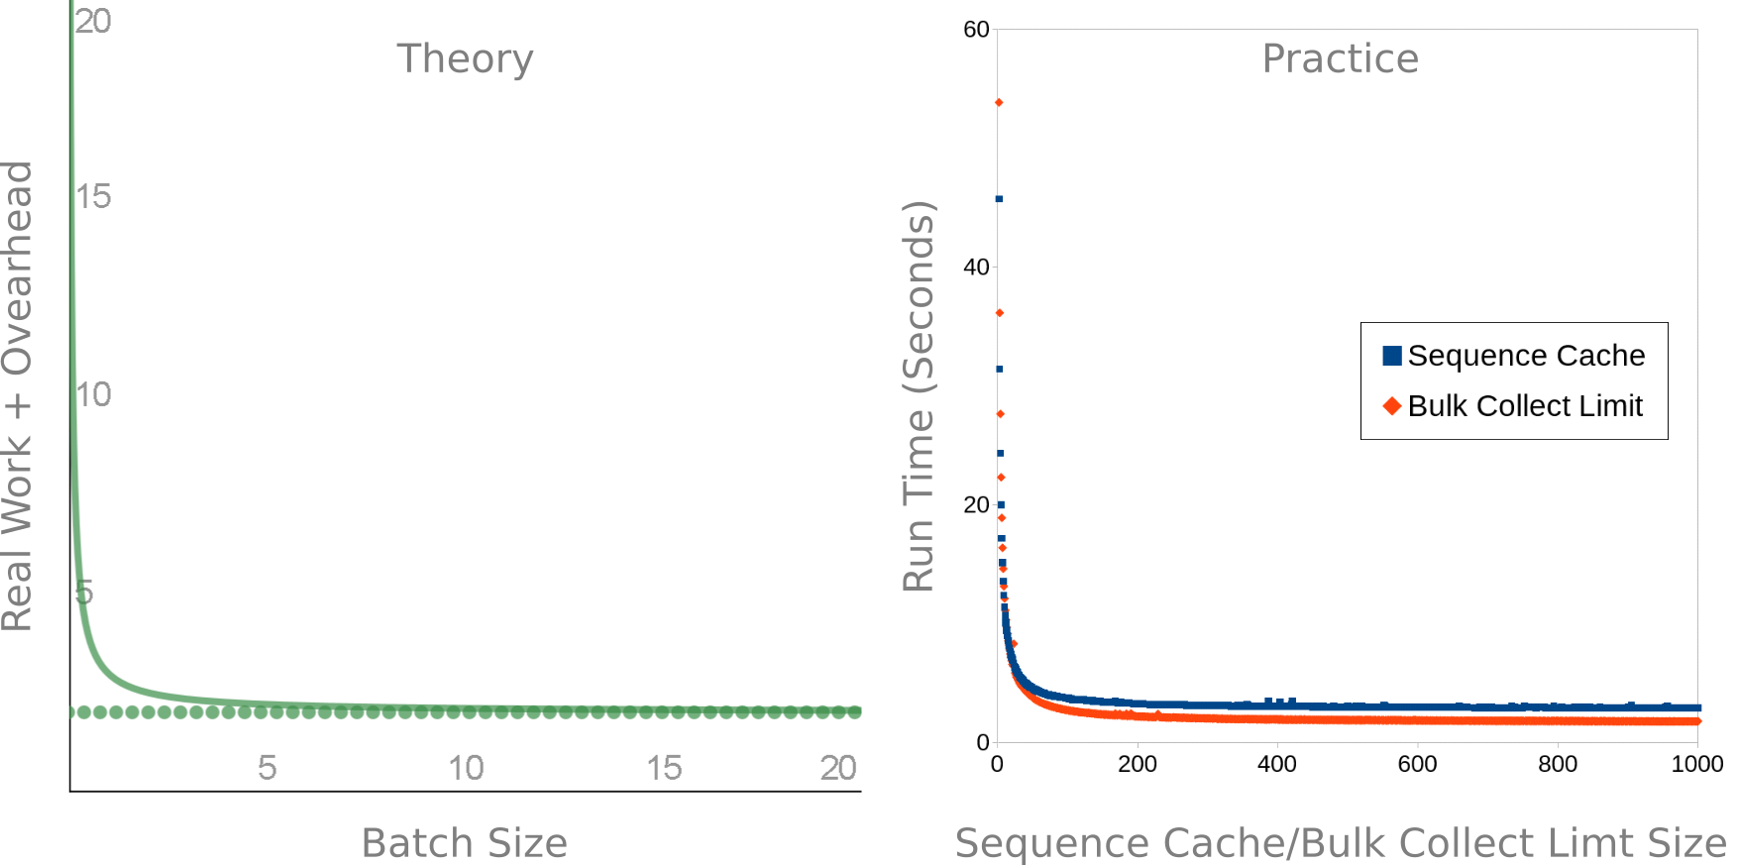
1/N - Theory vs. Practice

Slide 15
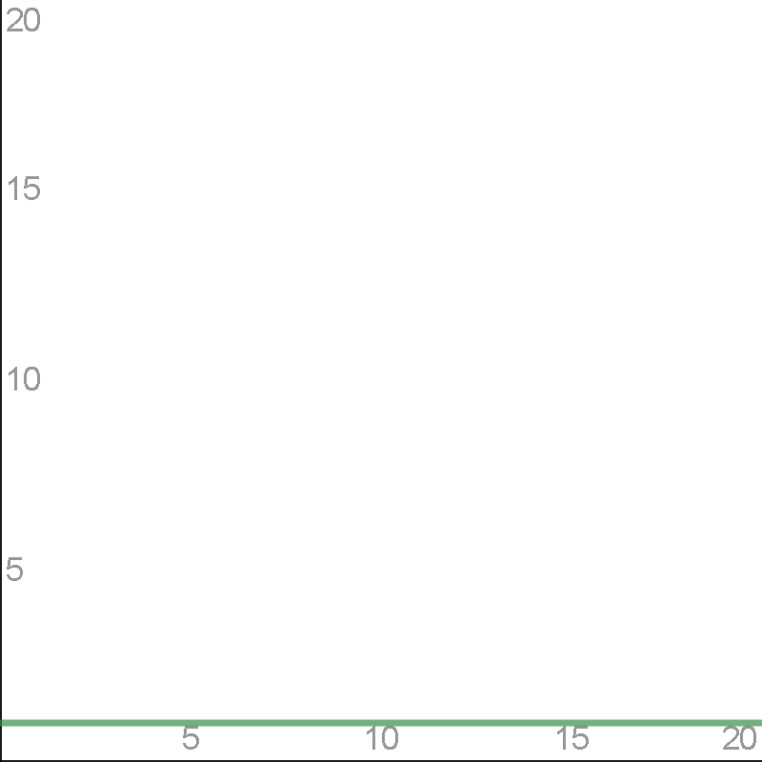
1

Slide 16
1 - What and Where
Constant time - boring is good
Hashing - partitioning, clusters, joins
Other - INSERT, CREATE, DROP, etc.

Slide 17
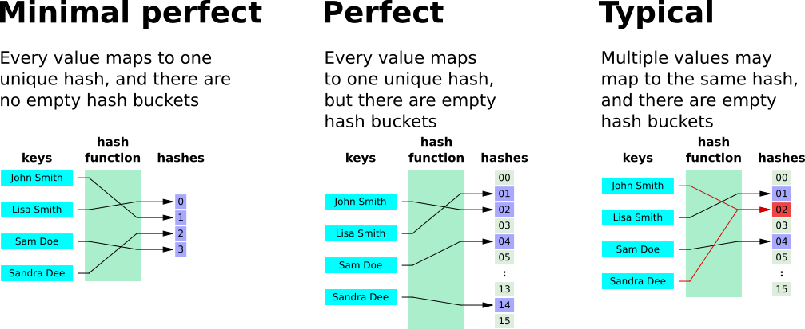
1 - Hashing Types and Tradeoffs
Notes:
By Jorge Stolfi - Own work, Public Domain, https://commons.wikimedia.org/w/index.php?curid=6601264

Slide 18
1 - Hash Partitioning
ORA_HASH
Good for retrieving large percentage of rows
Minimal but not perfect
Insert O(1), read is O(N/#_PARTITIONS)
Don't use huge number of partitions

Slide 19
1 - Hash Clusters
Unknown hash function
Good for retrieving small percentage of rows
Not minimal, may be perfect
O(1) reads, theoretically better than indexes
In practice it's slower (constants win)
Creating perfect hash increases table size 3x
Notes:
See this Stack Overflow answer, where I try and fail to create a useful constant-time index using hash clusters: https://stackoverflow.com/questions/32071259/constant-time-index-for-string-column-on-oracle-database

Slide 20
1 - Hash Joins
Somewhere between O(1) and O(N)
In practice, best way to join large tables

Slide 21
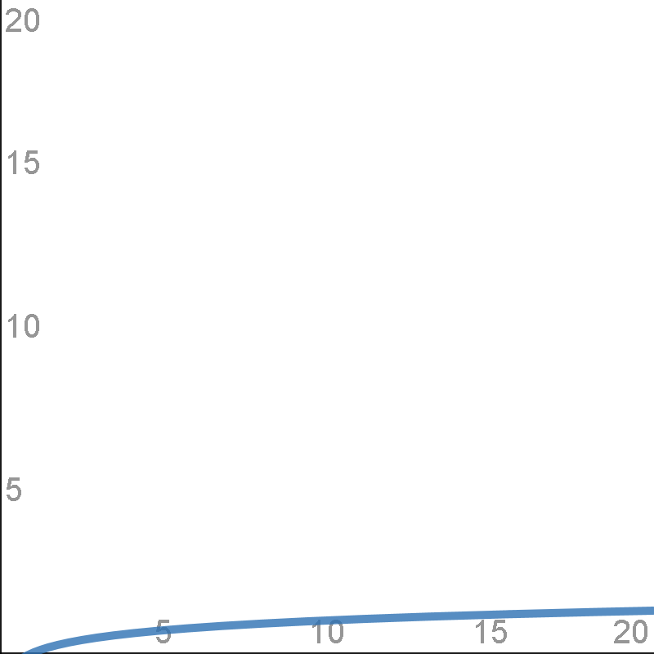
LOG(N)

Slide 22
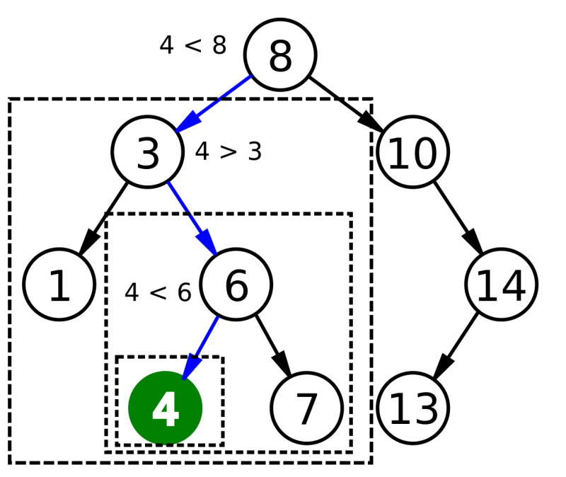
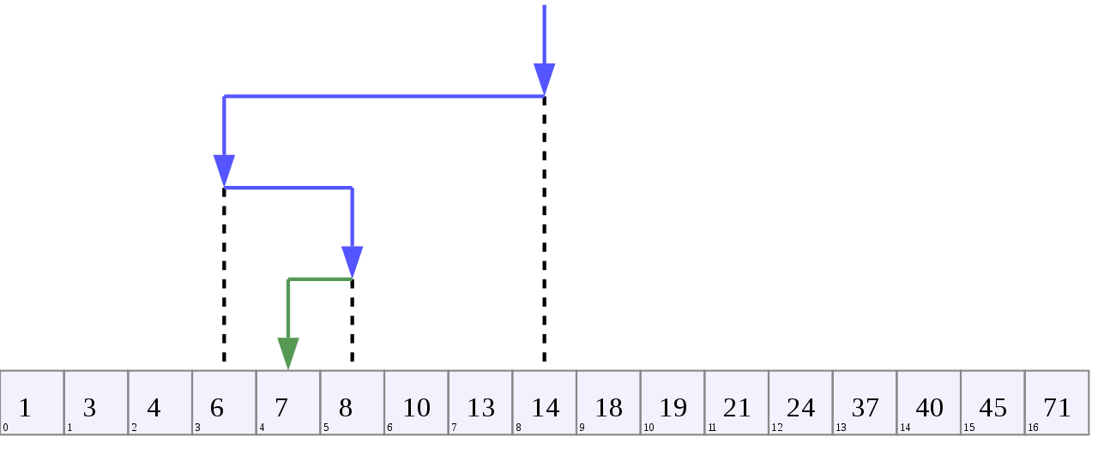
LOG(N) - B-Tree Visualizations
Notes:
Binary search algorithm image created by Chris Martin and is in the public domain.
Binary Search Depiction by AlwaysAngry is licensed under the Creative Commons Attribution-Share Alike 4.0 International license.

Slide 23
LOG(N) - What and Where
Binary math - each bit doubles
Binary search - each decision halves
Exponent and logarithm are opposites
Binary number 2^N, binary search LOG2(N)
Real indexes aren't binary, use LOG not LOG2

Slide 24
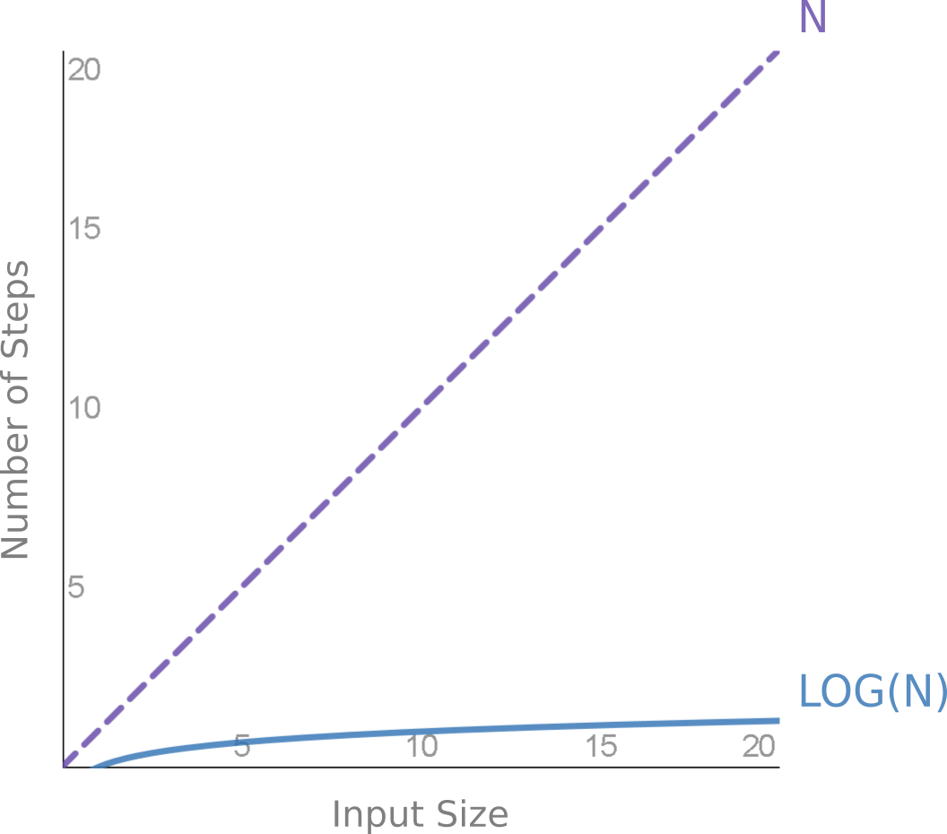
LOG(N) - Fastest for Small Access
Notes:
We're still only talking about accessing a single value.

Slide 25
LOG(N) - Why it Matters
This is why indexes are so fast
Data doubles, index access may stay the same
One search is LOG(N), N searches is N*LOG(N) and is discussed later

Slide 26
LOG(N) - Height of 3 Million Indexes
BLEVEL | Count
 | 899,972
0 | 2,097,419
1 | 245,841
2 | 42,303
3 | 2,601
4 | 54
5 | 24
6 | 25
7 | 3
9 | 1
11 | 1
Notes:
Index height does not grow fast in practice.
Generated by this query (run against the 350 databases I have access to)
select blevel, count(*) count
from dba_indexes
group by blevel
order by blevel nulls first;

Slide 27
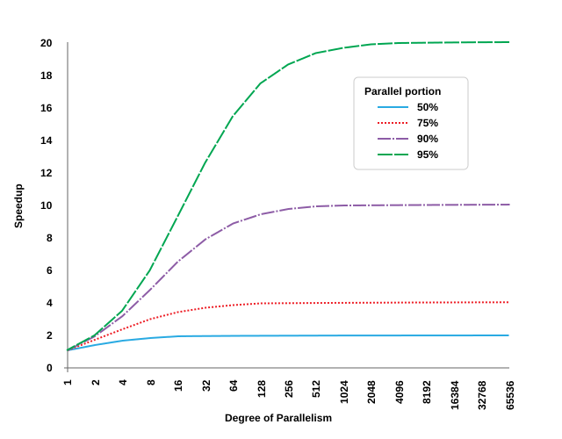
Amdahl's Law - 1/((1-P)+P/N)
Notes:
Amdahl’s law as a graph. Based on “Amdahl’s Law” by Daniels220, licensed under CC BY-SA.

Slide 28
Amdahl's Law - Depressing Results
Must parallelize EVERYTHING
Diminishing hardware returns: 128 cores at 95% = 17.4x 256 cores at 95% = 18.6x
Focus on parallelizing 128 cores at 96% = 21x

Slide 29
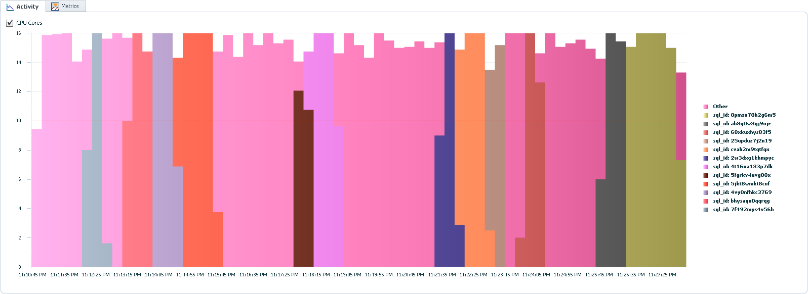
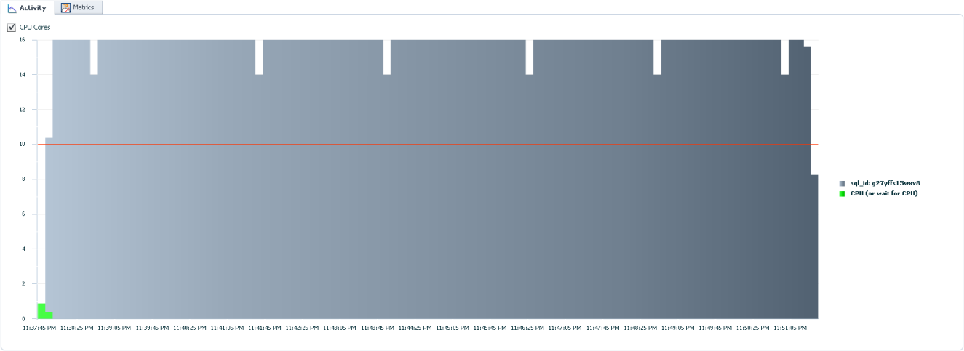
Amdahl's Law - Measure Carefully
Notes:
These pictures compare different ways to read a table in parallel. The top, colorful chart shows reading one-partition-at-a-time. The bottom, boring chart shows reading a table with a single SQL statement.
In this case, boring is good. The boring chart has very few edges, which means it's getting the most parallelism possible. If we want to improve performance by X we need to have X threads running at every possible moment.
We must have tools to measure and visualize utilization or we'd never know what's missing.

Slide 30
Amdahl's Law - Parallelize Everything
Don't only parallelize INSERT or SELECT
Index rebuilding
Gathering statistics
Constraint validation

Slide 31
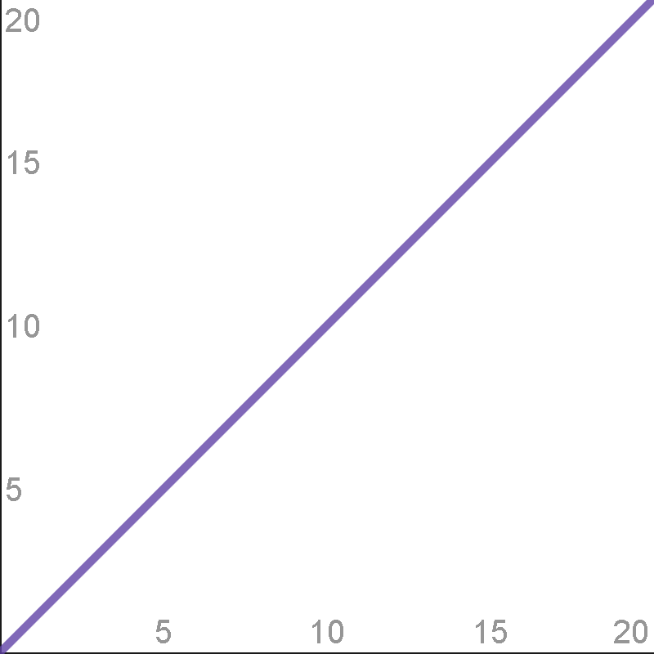
N

Slide 32
N - Linear Growth
Full table scan, fast full scan, parsing, basic compression, DML, etc.
In practice, most common function
Most effort is spent here
2x improvement is nice
Now it's time to compare functions
Notes:
Changes like using direct-path writes are "only" a 3x improvement, but that's still pretty awesome.

Slide 33
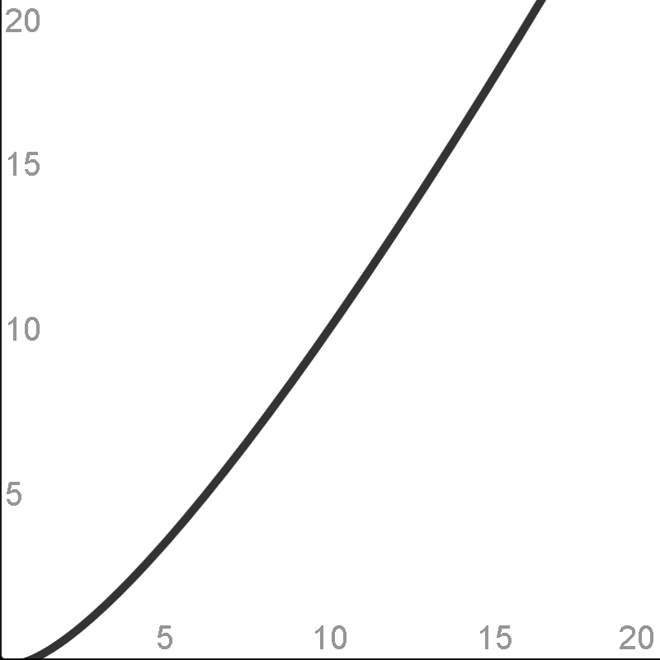
N * LOG(N)

Slide 34
N * LOG(N) - What and Where
Sorting
Iterated index access
Local index (partitioned indexes)

Slide 35
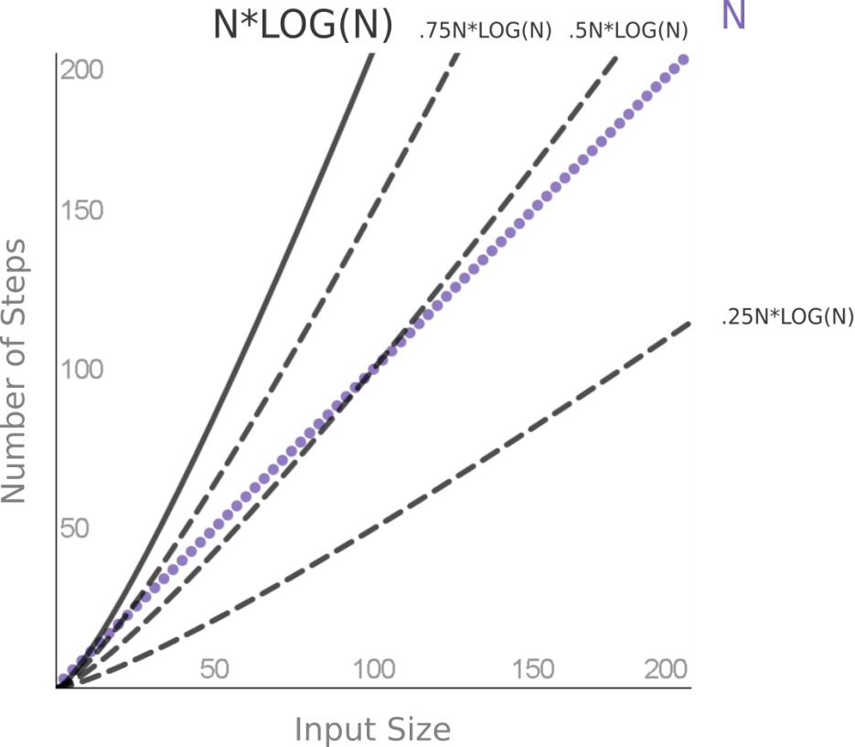
N * LOG(N) - Full Table Scan vs. Index
Notes:
Difficult choice: It's not obvious when a full table scan is cheaper than an index read. It depends on the percentage of the index and how big the data is.
Other factors: Clustering factor, multi-block versus single-block read time affect the choice.
Theory versus practice: Theory tells us the *shape*, but practice tells us the actual number where they diverge.
Cardinality: This is why cardinality is important. Oracle must know where on the X-axis we are, to know which choice is better.

Slide 36
N * LOG(N) - Sorting
ORDER BY time does not grow linearly
Space grows linearly
Index full scan - do sorting ahead of time

Slide 37
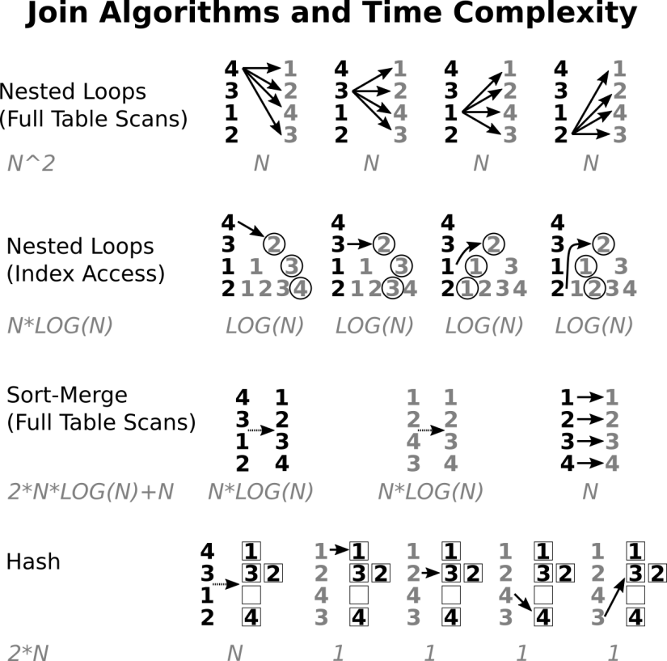
N * LOG(N) - Joining

Slide 38
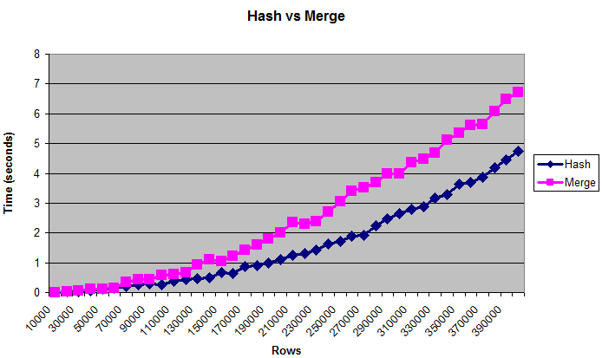
N * LOG(N) - Hash vs. Merge
Hash is worse than O(2N), but better than O(N*LOG(N))
Notes:
Chart is from my answer here: https://stackoverflow.com/questions/8188093/oracle-always-uses-hash-join-even-when-both-tables-are-huge

Slide 39
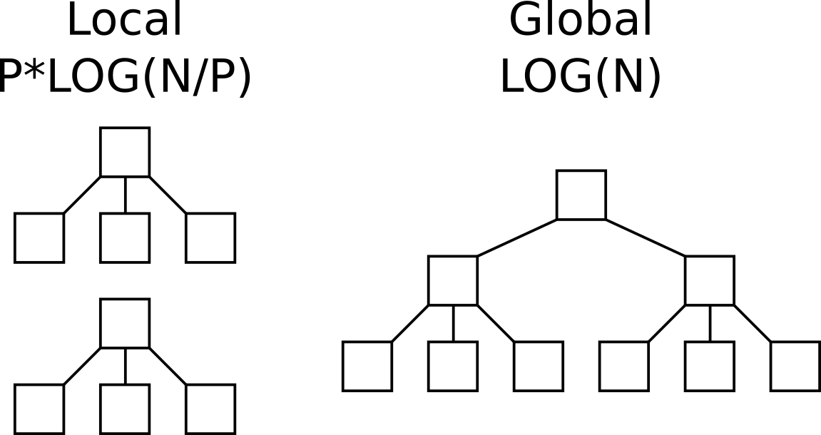
N * LOG(N) - Local vs Global Indexes

Slide 40
N * LOG(N) - Gathering Statistics
Counting distinct is like sorting - O(N*LOG(N))
Approximate NDV is O(N) instead of O(N*LOG(N))
Cardinality vital, but estimate good enough
Always use default for ESTIMATE_PERCENT

Slide 41
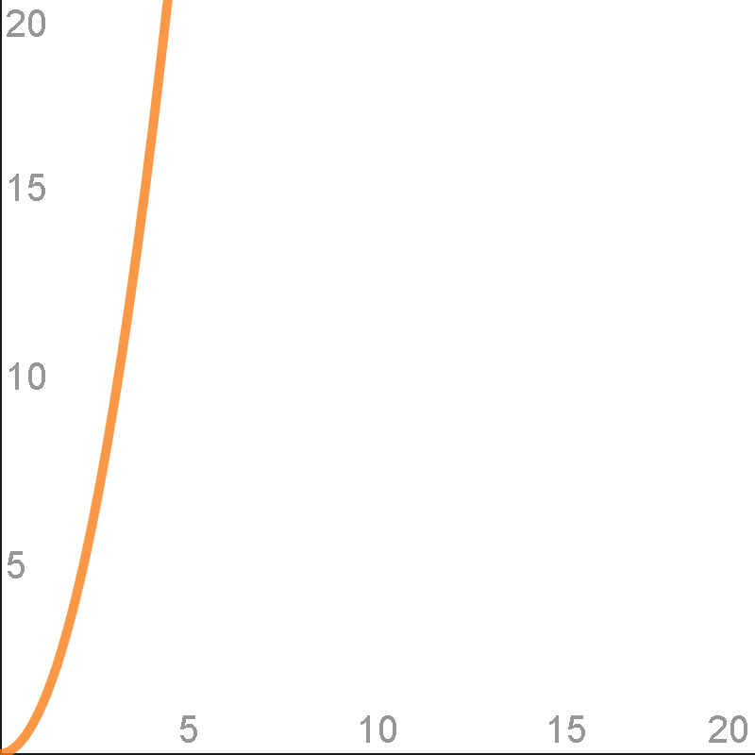
N^2

Slide 42
N^2 - What and Where
Nested loops ------------------------------------ | Id | Operation | Name | ------------------------------------ | 0 | SELECT STATEMENT | | | 1 | NESTED LOOPS | | | 2 | TABLE ACCESS FULL| TEST1 | | 3 | TABLE ACCESS FULL| TEST2 | ------------------------------------
Pseudo-code: FOR i IN 1 .. TEST1.COUNT LOOP FOR j in 1 .. TEST2.COUNT LOOP ("i" and "j" are both inputs, let's call them "n")
MODEL, parse time for 500+ UNION ALL

Slide 43
N^2 - Why it Matters
N^2 is horrible, avoid at all costs
Except near 0 where constants dominate (cross joins are not always evil)

Slide 44
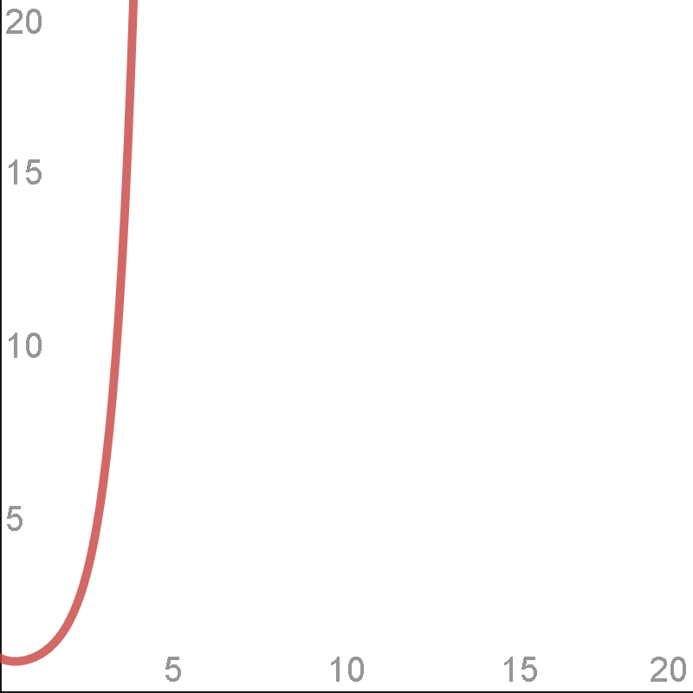
N!

Slide 45
N! - What and Where
N factorial. 3! = 3 * 2 * 1
Grows quickly: 5! = 120, 10! = 3,628,800
Occurs when listing all possible orders
Optimizer when finding join order
Our memory when visualizing join order

Slide 46
N! - Why it Matters
2 small sets is less complex than one big set
10! >> 2 * 5!
Pseudo-code: select * from table1, table2, table3, table4, table5, table6, table7, table8, table9, table10 ... versus: select * from ( select * from table1, table2, table3, table4, table5 ... ) view1 join ( select * from table6, table7, table8, table9, table10 ... ) view2 on view1.something = view2.something

Slide 47
∞ - Why it Matters
Halting problem is O(∞)
Optimizer is really a satisficer
Don't expect miracles
Work with the forecast, don't throw it out because of a few bad examples
Gather stats manually and automatically

Slide 48
Summary
Programs = Algorithms + Data Structures
Computer science degree not necessary
A few simple functions explain most behavior
Constants can't always be ignored
Algorithm analysis is foundational to understanding performance

Slide 49
Questions?
jon@jonheller.org
281

